Slide 1
Communication, Estimation & Negotiation
Rahul Mohandas

Slide 2
S1-25_SEZG509 Communication, Estimation & Negotiation
Session #1 – Sunday, 27 July 2025
Rahul Mohandas

Slide 3
Discussion Topics
Introduction & Expectations
Why Stakeholder Engagement
Understanding the dimensions of negotiation
Breakout Room Activity
Essence of stakeholder engagement
Similarities between Leadership & Product Management

Slide 4
Corporate Adventures – 1996 – 2019
Sales transaction system handling over INR 30 Cr/ day
Brand scorecards monitoring brands with revenues of over EUR 25 Bn/ year
Travel systems handling over 1.2 Mn transactions/ month

Slide 5






Now A Solopreneur
Learning Facilitator
Advisor
Product Management
Leadership Development

Slide 6


Personal Background

Slide 7

You Are…
Motivation
Career progression
Gain respect of colleagues with your knowledge
Everyday activities
Working long hours during the week – evening calls
Spend “time” with family & friends
Weekends – attend classes
Weekdays – assignments/ mandatory reading
Age: Early 20s years
Tier 1/ 2 city
Working in IT service/ product company
Goal
Apply knowledge
Certification
Promotion
Frustrations
No time for anything else
Too much to do
Hard to stay motivated

Slide 8
My Learning Philosophy
1
Understand concept
2
Examples of application
3
Case Study application
4
Retrospective application
5
Real life application

Slide 9

Tell Me More…
https://forms.cloud.microsoft/r/jGPSKG6jX0
Notes:
https://forms.cloud.microsoft/r/jGPSKG6jX0

Slide 10
Class Structure
Slides
Class Discussion
Discussion Forum

Slide 11
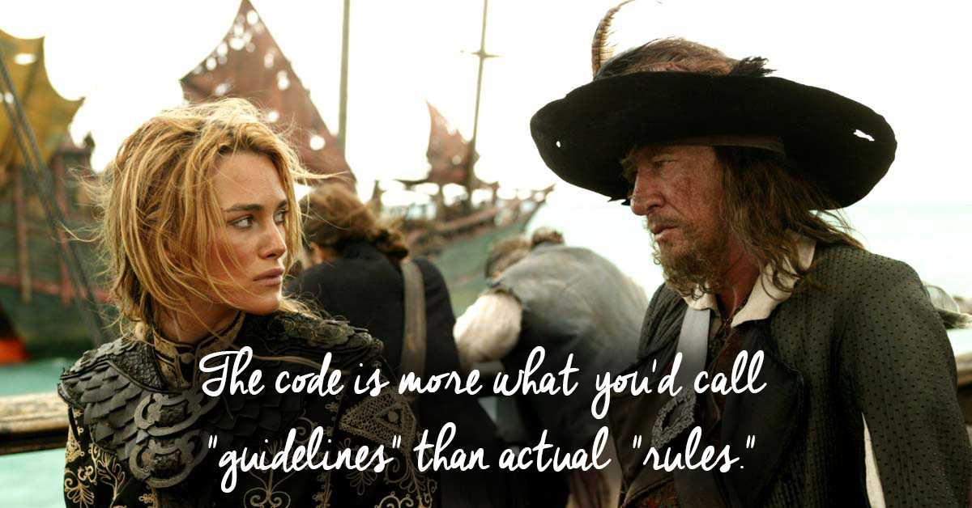
A Word Of Caution

Slide 12
Focus on…
Customer Value
Business Value
OR

Slide 13
A Product Management Framework
Stakeholder Engagement
Product Strategy
Development
Go To Market

Slide 14
Who Is A Stakeholder?

Slide 15
Who Is A Stakeholder?
A stakeholder is a party that has an interest in a company and can either affect or be affected by the business.
Source: https://www.investopedia.com/terms/s/stakeholder.asp

Slide 16
Stakeholder
Engagement
Management
OR

Slide 17
Dimensions of Negotiation
Scope
Priorities
Budget
Timeline
Responsibilities
Process
...

Slide 18
Breakout Rooms

Slide 19
Breakout Room Briefs
You are responsible for conceptualizing an ERP system to manage the IPL T20 tournament. To get started, identify all your external stakeholders
You are a Product Manager at Swiggy and tasked with getting the app ready for rollout in a new country. Who are the internal and external stakeholders that you need to work with to identify and address critical gaps in the product?
You are managing an in-house product at Infosys to track media spends. Your leadership team has tasked you with seeing if the media spend is making the desired impact with the various segments you are targeting. To start with, identify all the external stakeholders you are targeting.

Slide 20
Debrief – Rooms 1
You are responsible for conceptualizing an ERP system to manage the IPL T20 tournament. To get started, identify all the external stakeholders so that you can start to conceptualize the solution
<>
20

Slide 21
Debrief – Rooms 2
You are a Product Manager at Swiggy and tasked with getting the app ready for rollout in a new country. Who are the internal and external stakeholders that you would work with to identify and develop critical gaps in the product?
<>
21

Slide 22
Debrief – Rooms 3
You are managing an in-house product at Infosys to track media spends. Your leadership team has tasked you with seeing if the media spend is making the desired impact with the various segments you are targeting. To start with, identify all the external stakeholders you are targeting.
<>
22

Slide 23
Leadership
Inspire Teams
Take Risks
Create Value
to
and
What is the similarity with
Product Managers?

Slide 24
Next Week
Your Take On Week 1
Stakeholders for a Lean & Agile environment
Lean & Agile Mindset
Information networks
Communication and staying agile
Mindset elements
No decision Vs wrong decisions

Slide 25

Feedback Please
Or click here: https://forms.cloud.microsoft/r/Kuu4jqcDm7

Slide 26

Questions

